Slide 1
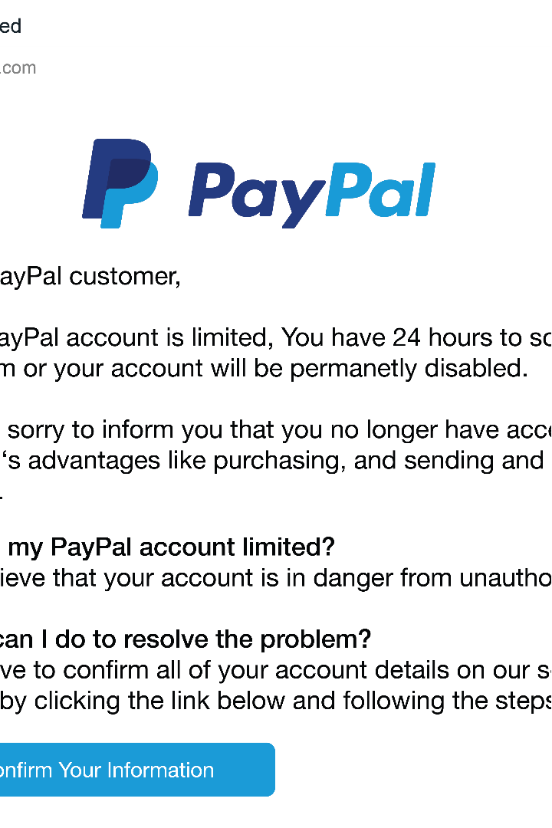



Introduction to Phishing Awareness
Phishing is a type of cyber attack where criminals attempt to trick you into revealing sensitive information or taking harmful actions. This training will equip you with the knowledge to identify and protect against phishing threats.
by Shantono Mitra

Slide 2
Understanding Phishing Threats
1
Financial Fraud
2
Data Breaches
3
Malware Infection
Phishers may try to steal your login credentials, credit card numbers, or other financial information.
Successful phishing attacks can lead to data breaches, allowing criminals to access sensitive company or personal data.
Phishing emails may contain malware that can infect your device and compromise your system.

Slide 3
Common Phishing Tactics
Impersonation
Urgent Requests
Malicious Links
Phishers may pretend to be a trusted organization, like a bank or government agency, to lure you into revealing information.
Phishing emails often create a false sense of urgency to pressure you into taking immediate action.
Phishing emails may contain links that lead to fake websites designed to steal your data.

Slide 4
Identifying Phishing Emails
Sender Address
Spelling and Grammar
Check the email address to see if it matches the organization it claims to be from.
Phishing emails often contain typos, poor grammar, and unprofessional language.
Suspicious Links
Unusual Requests
Hover over links to see if the URL matches the claimed destination.
Be wary of emails asking you to share sensitive information or take unexpected actions.

Slide 5
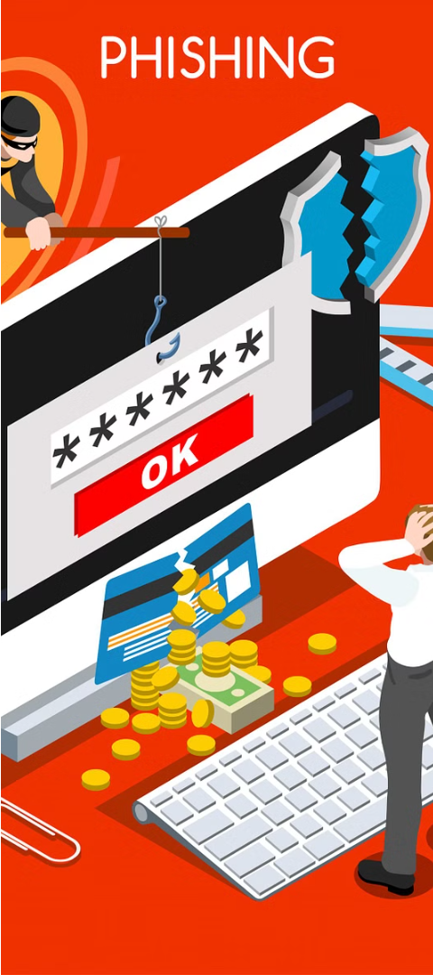
Protecting Yourself from Phishing
1
Be Cautious
Approach all unsolicited emails and requests with skepticism.
2
Verify Information
Confirm the legitimacy of any requests by contacting the organization directly.
3
Use Security Tools
Rely on antivirus, anti-malware, and email filtering software to detect and block phishing attempts.

Slide 6



Reporting Suspicious Activity
Report to IT
Flag Messages
Contact Authorities
Notify your IT department about any suspected phishing emails.
Mark suspicious emails as spam or junk to help train email filters.
Report incidents of identity theft or financial fraud to the appropriate authorities.

Slide 7
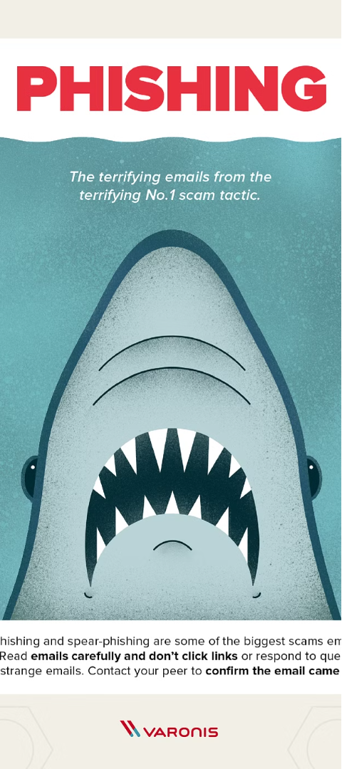



Best Practices for Phishing Prevention
Stay Informed
Keep up to date on the latest phishing tactics and best practices.
Educate Employees
Provide regular phishing awareness training to all staff.
Implement Security
Deploy robust email filters, anti-malware tools, and other cybersecurity measures.

Slide 8
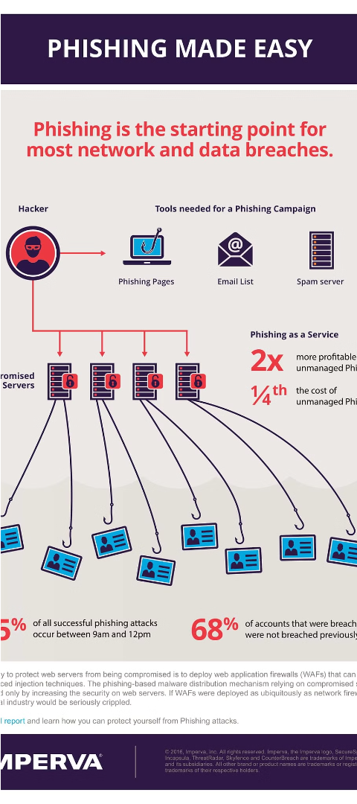
Conclusion and Resources
1
Recap
2
Additional Resources
This training has equipped you with the knowledge to identify and protect against phishing threats.
Explore our online resources for more information on phishing prevention.
3
Stay Vigilant
Remain cautious and report any suspicious activity to help keep our organization secure.

